Slide 1
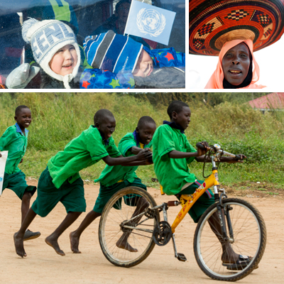
UN Observances
HUMAN RIGHTS DAY
10 December
UN Photos
Notes:
Source:
http://www.un.org/en/events/humanrightsday/2013/index.shtml
Photos:
http://www.un.org/en/events/humanrightsday/img/humanrights2014image.jpg

Slide 2
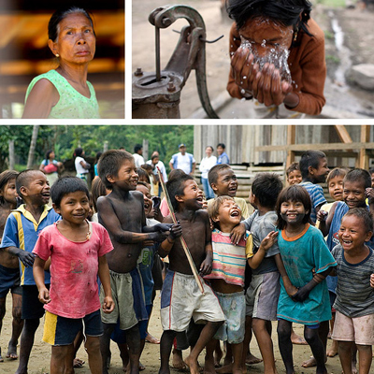
Publication Details:
This resource has been prepared by Rees D. Barrett, Education Convenor, UNAAWA.
Feedback from teachers will be gratefully received and used in the review of this resource.
© 2015 United Nations Association of Australia – WA Division.
UN Photos
Notes:
First approved July 2015 (v1.1), reviewed July 2016 (v2.1), next review by July 2017
Photos:
http://www.un.org/en/events/humanrightsday/img/home_img_400.jpg
Western Australian Curriculum Links:
Content: Year 10 Geography, Years 4 to 10 Civics and Citizenship, Year 10 History; Cross-Curriculum Priorities: Aboriginal and Torres Strait Islander Histories and Cultures, Australia and Asia; General Capabilities: Intercultural Understanding; Values: Respect and concern for others and their rights, Social and Civic Responsibility.
Teacher Notes:
This resource has been designed to support UN Observances in schools and their communities.

Slide 3
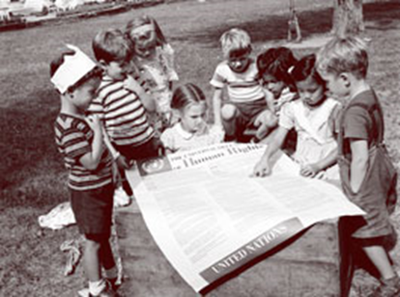
Human Rights Day
The UN General Assembly proclaimed 10 December as Human Rights Day in 1950, to bring to the attention ‘of the peoples of the world’ the Universal Declaration of Human Rights (adopted 10/12/1948) as the common standard of achievement for all peoples and all nations.
Children attending the UN International Nursery School looking at a poster of the Universal Declaration of Human Rights.
UN Photo

Slide 4
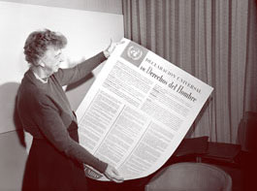
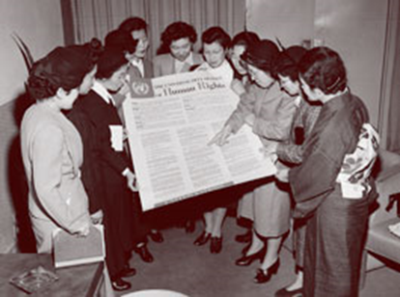
The UDHR (Universal Declaration of Human Rights)
President and Chair of the Commission on Human Rights, Eleanor Roosevelt, looking at the Universal Declaration of Human Rights in Spanish.
UN Photo
A group of Japanese women looking at the Universal Declaration of Human Rights during their visit to the UN's interim headquarters in Lake Success, New York, 1950.
UN Photo
Notes:
Teacher Notes:
The Universal Declaration of Human Rights is also referred to using the acronym UDHR.

Slide 5
“It is difficult to imagine today just what a fundamental shift the Universal Declaration of Human Rights represented when it was adopted.
In a post-war world scarred by the Holocaust, divided by colonialism and wracked by inequality, a charter setting out the first global and solemn commitment to the inherent dignity and equality of all human beings, regardless of colour, creed or origin, was a bold and daring undertaking.”
High Commissioner for Human Rights, Louise Arbour

Slide 6
The UDHR is the foremost statement of the rights and freedoms of all human beings.
It consists of a preamble and 30 articles, setting out a broad range of fundamental human rights and freedoms to which all men women and children, everywhere in the world, are entitled without any distinction.
It has been translated into more than 380 languages and dialects.

Slide 7
The UDHR
Article 1.
All human beings are born free and equal in dignity and rights. They are endowed with reason and conscience and should act towards one another in a spirit of brotherhood.

Slide 8
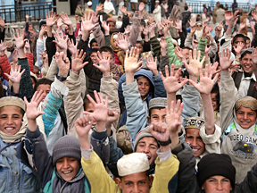
Human Rights Day Themes
On 10 December each year the UN focuses world attention on important aspects of protecting human rights.
For example, the 2009
theme ‘embrace
diversity’ highlighted
discrimination against
people who are vulnerable
or seen to be different.
UN Photo

Slide 9
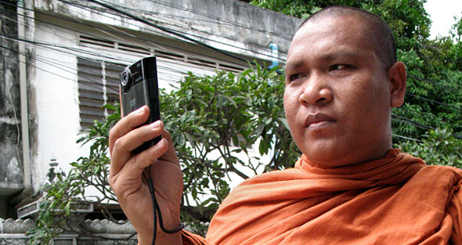
Human Rights Day 2010
Human Rights Day 2010 featured the work of Human Rights Defenders against discrimination
by campaigning for equitable laws, reporting human rights violations and supporting victims.
Many Human Rights Defenders are anonymous and undertake their work at great personal risk.
Loun Sovath defends communities affected by land grabs in Cambodia using modern technology to document abuses.
UN Photo

Slide 10
Famous Human Rights Defenders
Throughout human history there have been many famous men and women who have defended human rights.
Research the lives and work of some human rights heroes. For example:
Mohandas Gandhi
Martin Luther King
Mother Teresa
Nelson Mandela
Aung San Suu Kyi
Notes:
Photo Source:
Word 2010 Clip Art

Slide 11
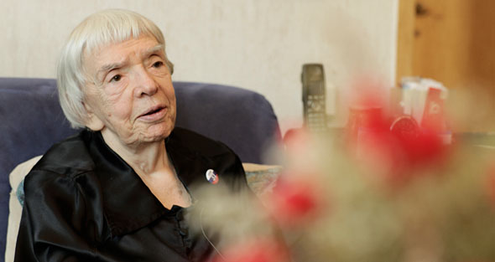
Human Rights Day
What will you do to celebrate Human Rights Day?
How might you act as a Human Rights Defender?
Test your knowledge of Human Rights Defenders at:
http://www.un.org/en/events/humanrightsday/2010/test.asp
UN Photo
Ludmilla Alexeeva is a Human Rights Defender who stands up for human rights protection through her work with the Moscow Helsinki Group.

