Slide 1
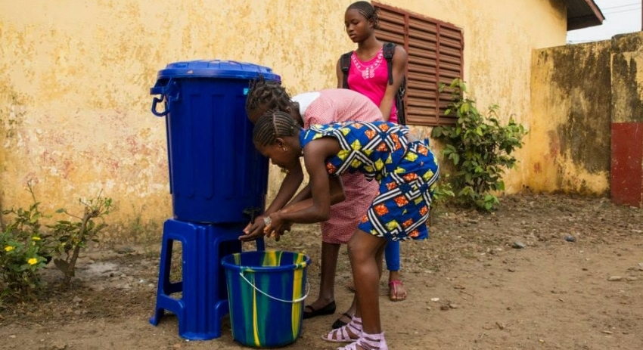
UN Observances
World Water
Day
22 March
Notes:
Western Australian Curriculum Links - Content: Year 7, 8, 9 and 10 Geography; Cross-curriculum Priority – Sustainability; General Capabilities: Critical and Creative Thinking; Values: Environmental Responsibility.
Teacher Notes:
This resource has also been designed to support UN Observances in schools and their communities.
Source:
http://www.un.org/en/events/waterday/

Slide 2
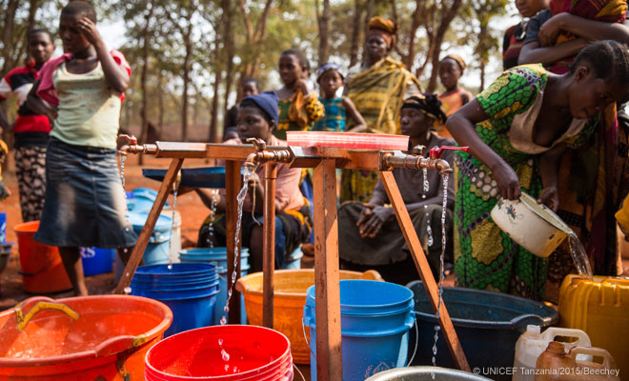
Publication Details:
This resource has been prepared by Rees D. Barrett, School Programs Coordinator, UNAAWA.
Feedback from teachers will be gratefully received and used in the review of this resource.
© 2016 United Nations Association of Australia – WA Division.
Notes:
First approved July 2015 (v1.1), reviewed March 2016 (v2.1), next review by July 2017
Photo Source:
http://www.unicef.org/

Slide 3
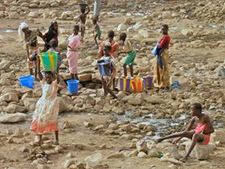
World Water Day
International World Water Day is held annually as a means of focusing attention on the importance of freshwater and promoting the sustainable management of water resources.
[UN Photo]
Notes:
Photo Source:
http://www.unwater.org/

Slide 4
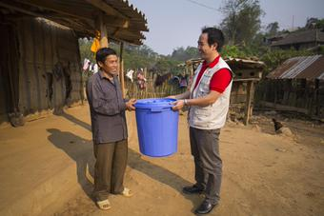
Water and Sustainability
World Water Day was first held 22 March 1993.
Why is clean, freshwater vital for sustainable development?
[UN Photo]
Notes:
Photo:
2014 World Water Day – distribution of clean water containers to 205 minority households in Vietnam.
Photo Source:
https://twitter.com/SPVietnam/status/577767621275205634/photo/1

Slide 5
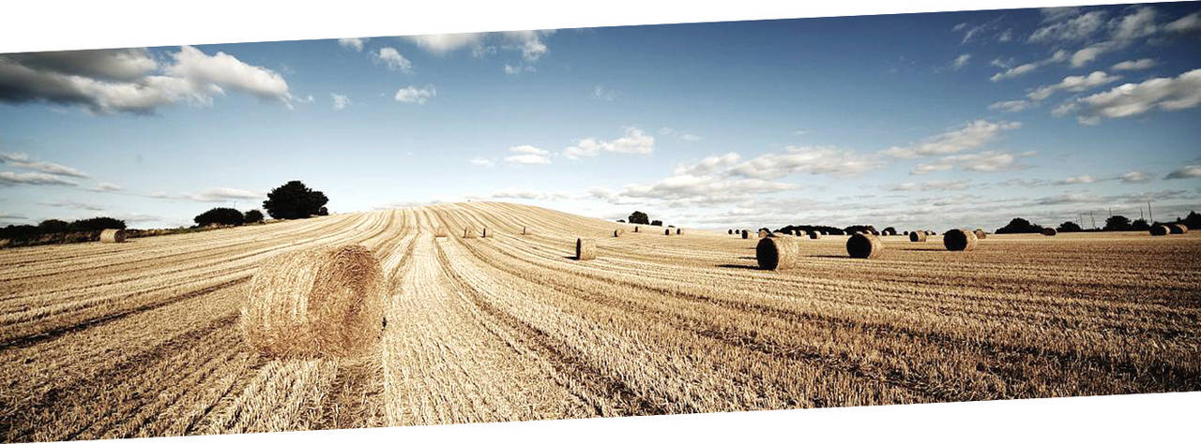
Water and food supply
Experts estimate it takes 15 000 litres of water to produce two steaks.
[UN Photo]

Slide 6
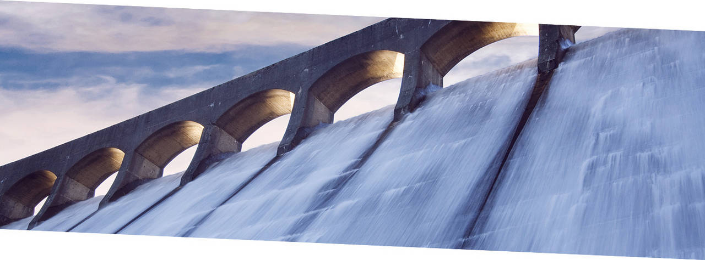
Water and energy
Water is a source of renewable energy.
[UN Photo]

Slide 7
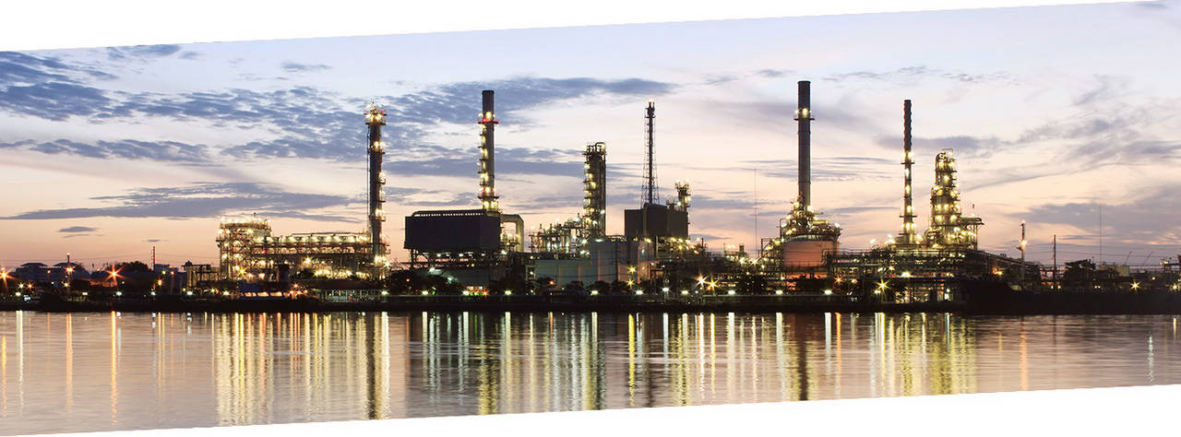
Water and industry
More water is needed to manufacture a car than to fill a swimming pool.
[UN Photo]

Slide 8
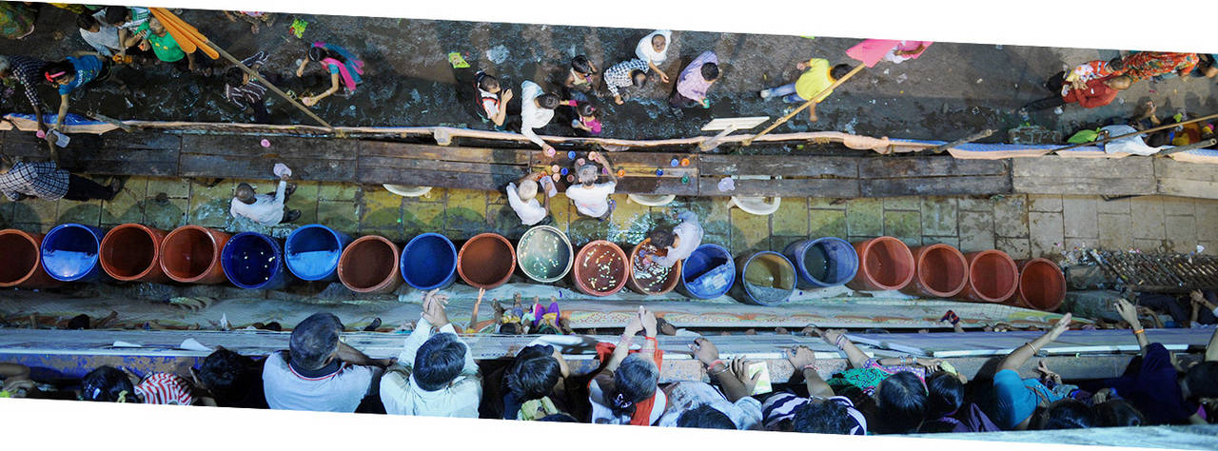
Water is vital for cities
Every week another million people move into cities. They all need access to water.
[UN Photo]

Slide 9
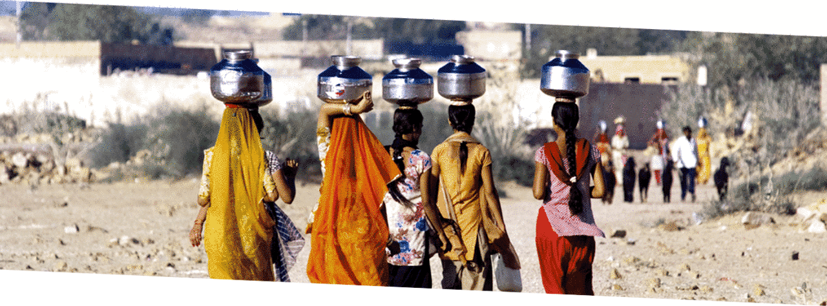
Freshwater access
An estimated 750 million people do not have access to an improved water supply.
This affects the health of people – especially women and children.
[UN Photo]

Slide 10
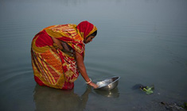
Freshwater access
These people spend significant time collecting water from natural sources.
Lack of fresh water affects the health of people – especially women and children.
A woman washes a pot in a river, Dhaka District, Bangla Desh.
[UNICEF Photo]
Notes:
Photo Source:
http://www.unicef.org/

Slide 11
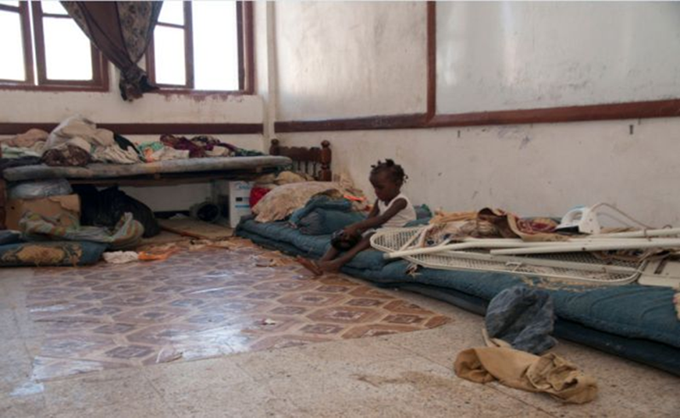
Water and Sanitation
Some 2.5 billion people do not have access to improved sanitation - a major factor affecting health.
[UN Photo]

Slide 12
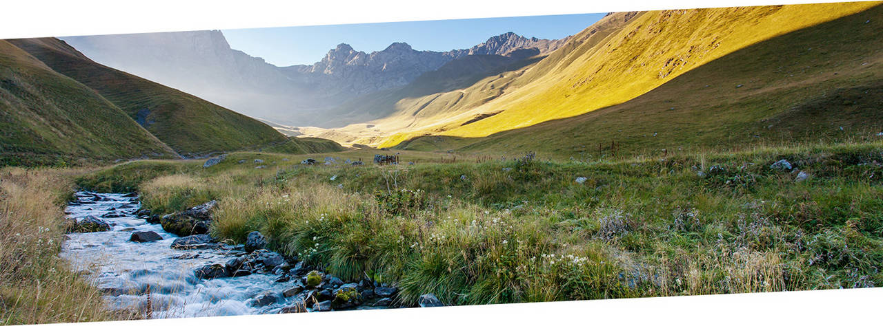
UN World Water Development Report 2015
The report estimates that by 2030 the world will have 40% less water than its people need – unless we improve the way we manage this precious resource.
[UN Photo]

Slide 13
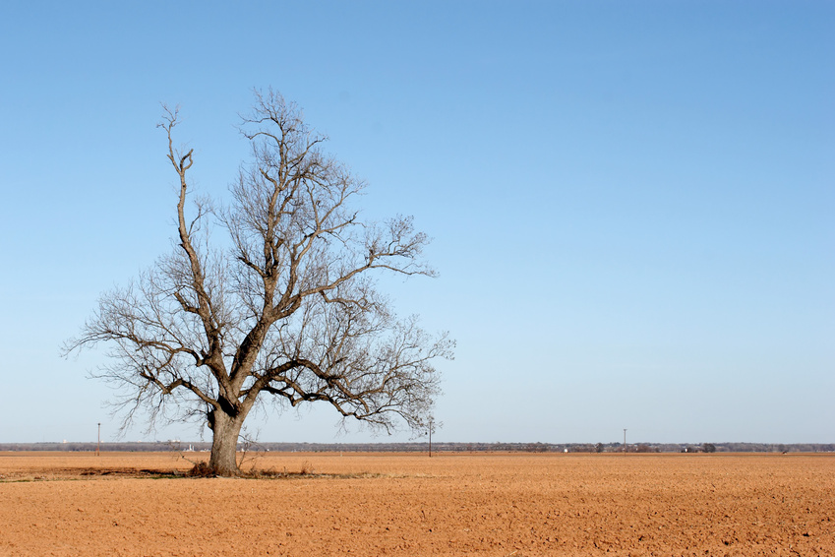
Water and Climate Change
Global warming is also predicted to increase water scarcity in some parts of the world and increase flooding in other parts.
[UN Photo]

Slide 14
Sustainable Development Goal
Universal action - came into force 1 Jan 2016
17 goals to transform the world by 2030
Goal # 6 Ensure access of all people to clean water and sanitation
8 targets to be closely monitored
Progress achieved (1990 – 2015 Millennium Development Goals) global population with access to improved drinking water 76% to 91%
[UN Photo]
Notes:
For Further Information:
http://www.un.org/sustainabledevelopment/water-and-sanitation/

Slide 15
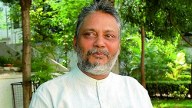
Think Global - Act Local
International cooperation, new ideas and action will help to make the world water-wise.
For example, Rajendra Singh (pictured) won the 2015 Stockholm Water Prize for his ideas and actions to improve water supply in rural India.
[UN Photo]

Slide 16
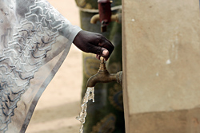
Think Global - Act Local
Clean drinking water runs freely from a communal water point in Ndombil, Senegal.
[UN Photo]
What will you do to mark World Water Day?
Notes:
Photo Source:
http://www.un.org/en/globalissues/briefingpapers/mdgs/index.shtml

